Slide 2

Applied Algorithm Lab
Range minimum query

Slide 3
Range minimum query
Calculate the sum of the minimal numbers in some intervals of a given sequence
Given a sequence of n integers a₀, …, a_{n-1}.
Denote rmq(i, j): the minimum of a_{i}, a_{i+1}, . . ., a_{j}.
Given m pairs (i₁, j₁),. . ., (i_{m}, j_{m})
Compute the sum: Q = rmq(i₁, j₁) + . . . + rmq(i_{m}, j_{m})
Input: the sequence and the intervals
Output: the sum

Slide 4
Range minimum query
Example
stdin | stdout
16 2 4 6 1 6 8 7 3 3 5 8 9 1 2 6 4 4 1 5 0 9 1 15 6 10 | 6 Explain: 1+1+1+3 = 6

Slide 5
Range minimum query
Idea to solve #1:
for each pair of (i, j), find the minimum number in the interval
sum over all pair
-> easy, but too many comparisons, high complexity as the number of pairs goes higher

Slide 6

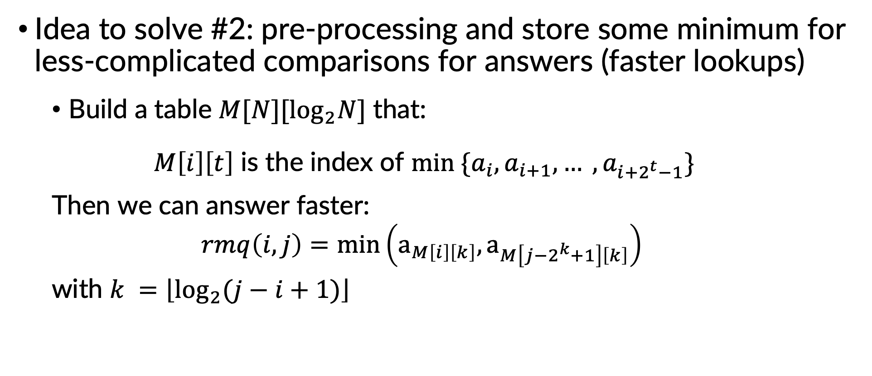


Range minimum query
Idea to solve #2: pre-processing and store some minimum for less-complicated comparisons for answers (faster lookups)
Build a table $M[N][\log_{2}N]$ that:
$M\left[i\right]\left[t\right]$ is the index of $min \{a_{i}, a_{i+1}, … , a_{i+2^{t}−1}\}$
Then we can answer faster:
$$rmq\left(i,j\right)=\min\left(a_{M\left[i\right]\left[k\right]}, a_{M\left[j−2^{k}+1\right]\left[k\right]}\right)$$
with $k =\left\lfloor \log_{2}{(j−i+1)}\right\rfloor$
$$i+2^{k}−1≥ j−2^{k}$$
$$min⁡\{a_{j−2^{k}+1},…, a_{j}\}$$
$$min⁡\{a_{i}, a_{i+1}, … , a_{i+2^{k}−1}\}$$

Slide 7

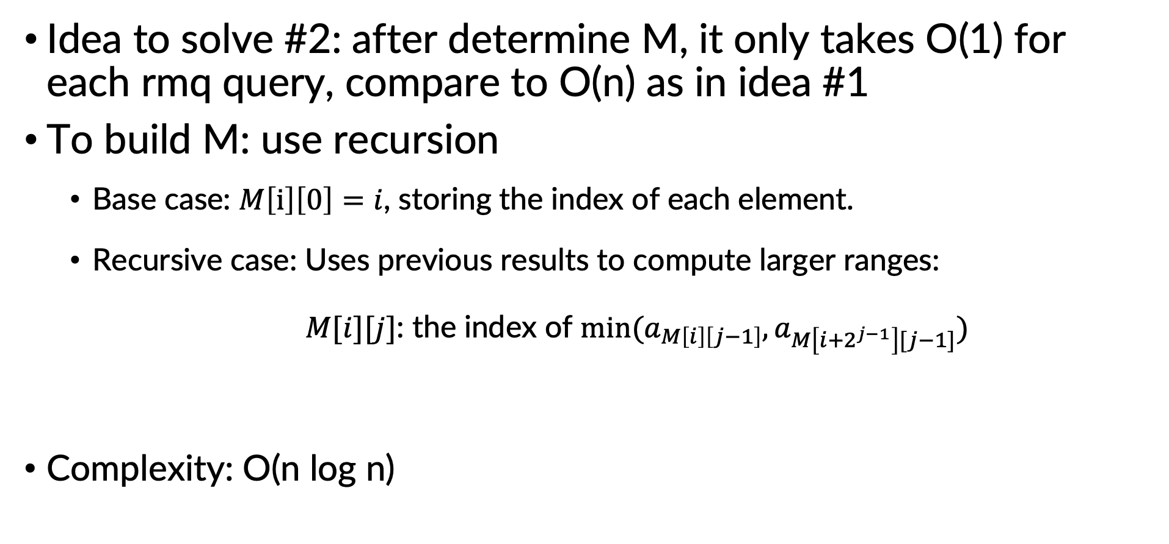

Range minimum query
Idea to solve #2: after determine M, it only takes O(1) for each rmq query, compare to O(n) as in idea #1
To build M: use recursion
Base case: $M\left[i\right]\left[0\right]=i$, storing the index of each element.
Recursive case: Uses previous results to compute larger ranges:
$M[i][j]$: the index of $min⁡(a_{M\left[i\right]\left[j−1\right]},a_{M\left[i+2^{j−1}\right][j−1]})$
Complexity: O(n log n)
$$min⁡\{a_{i}, a_{i+1}, … , a_{i+2^{j−1}−1}\}$$
$$min⁡\{a_{i+2^{j−1}}, … , a_{i+2^{j}−1}\}$$

Slide 8
THANK YOU !

